Slide 1
Reference
Intelligent Buildings

Slide 2
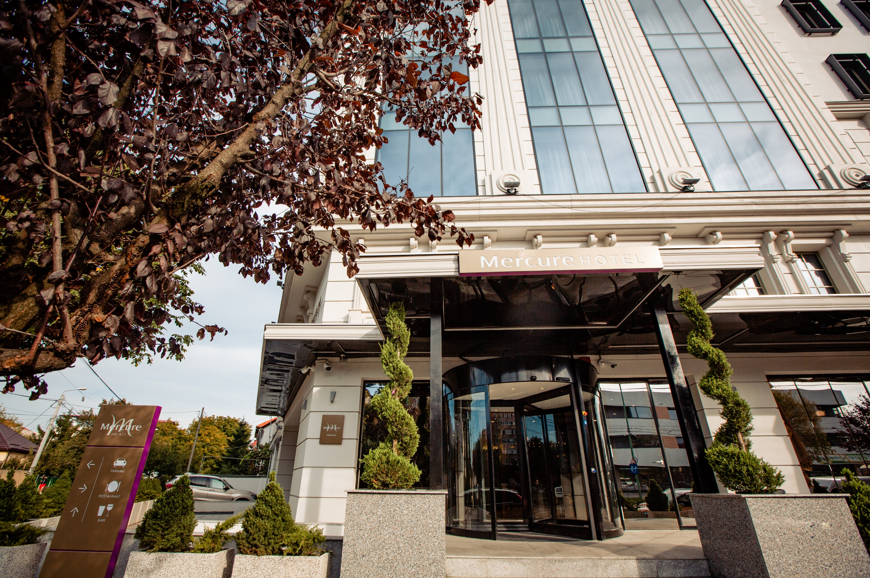
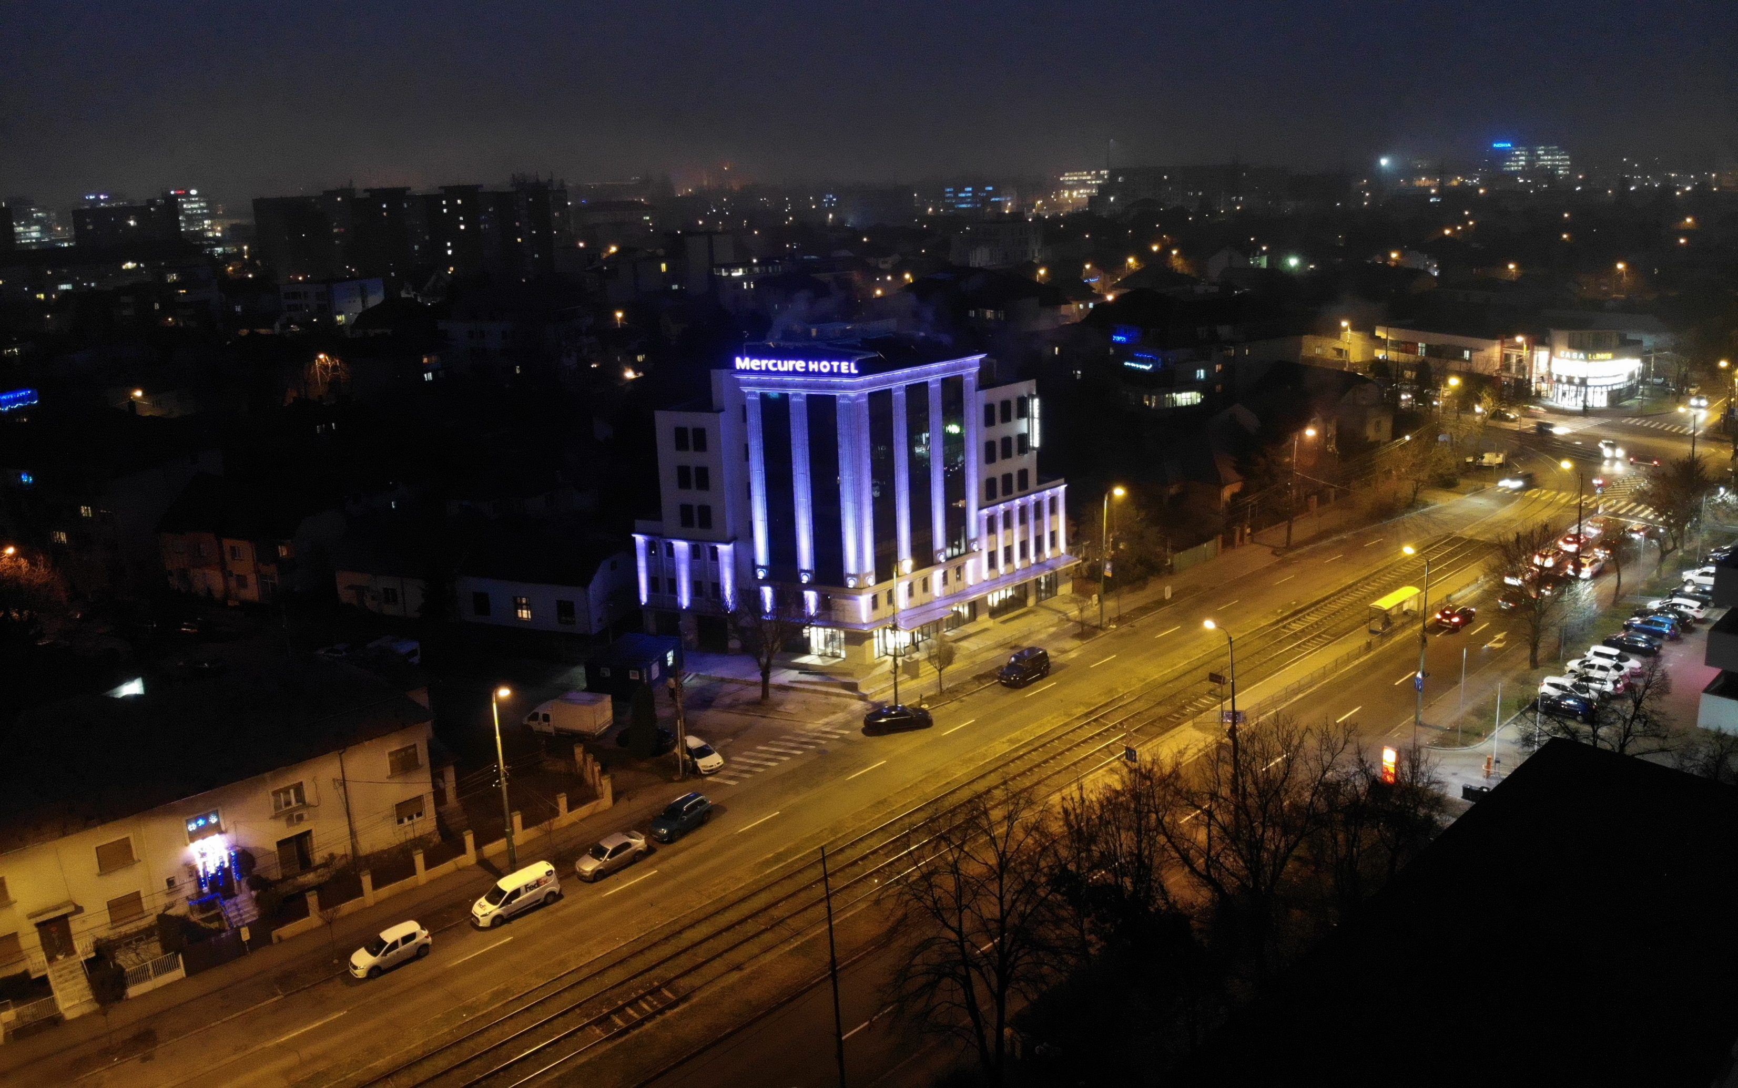
Hotel Mercure
Mercure Hotel Project is a 60 rooms, 4 stars+ luxurious hotel, utilizing KNX system for Comfort, Luxury & Energy-Saving. KNX Guest Room Management System has been proposed with light dimming & switching, blinds control, temperature control, air flow control, motion sensors, hotel signaling (DND/MUR) and scenes recall.
Integration with VingCard Door Lock system, MICROS Fidelio, audio system, DALI lights, ModBus system used for controlling HVAC sources were major challenges to adapt and utilize. Such processes and integrations have been applied in a complex sequence to achieve Comfort, Luxury, & Energy-saving without affecting quality using a building management software which allows to control and monitor 5,000 data points.
The BMS system is responsible for trending, reporting, alarms and maintenance management of all data points.

Slide 3
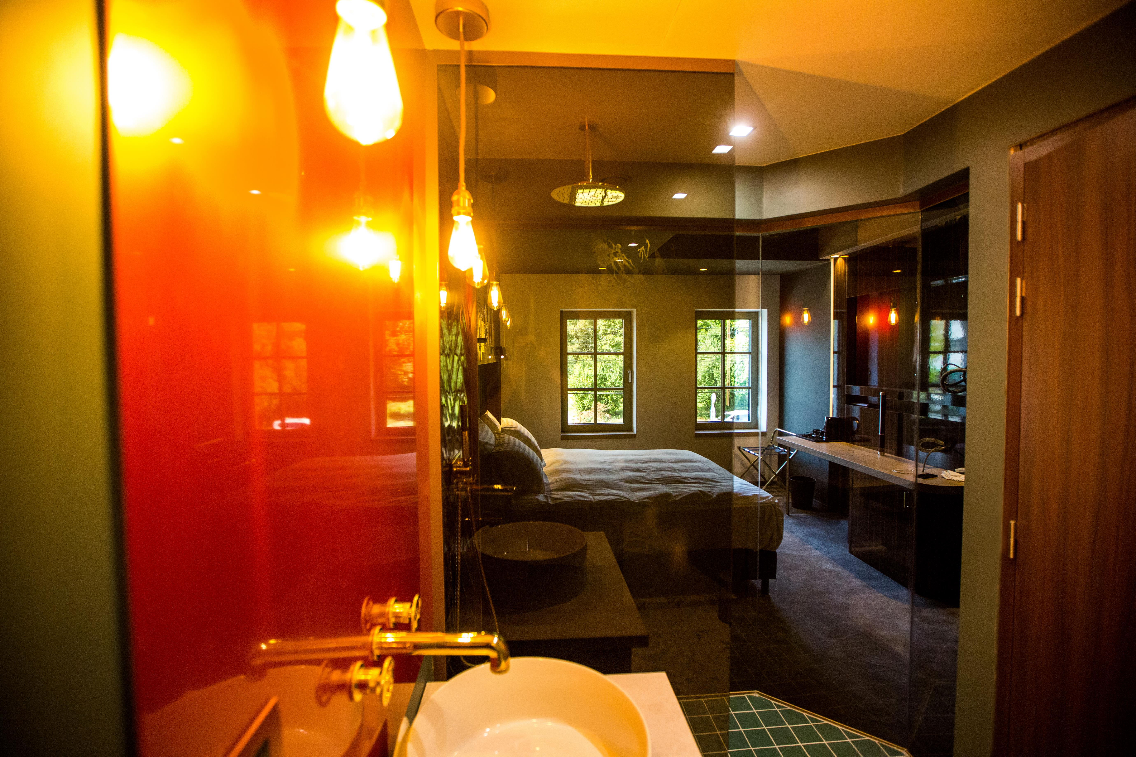
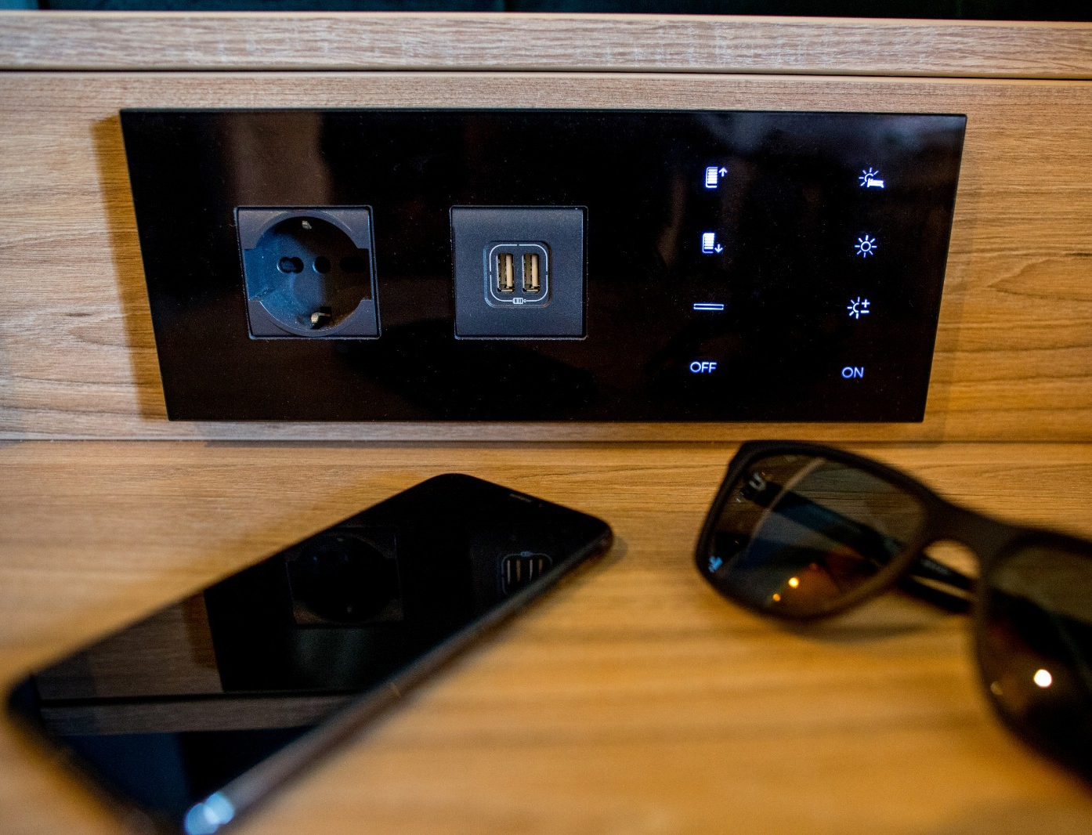
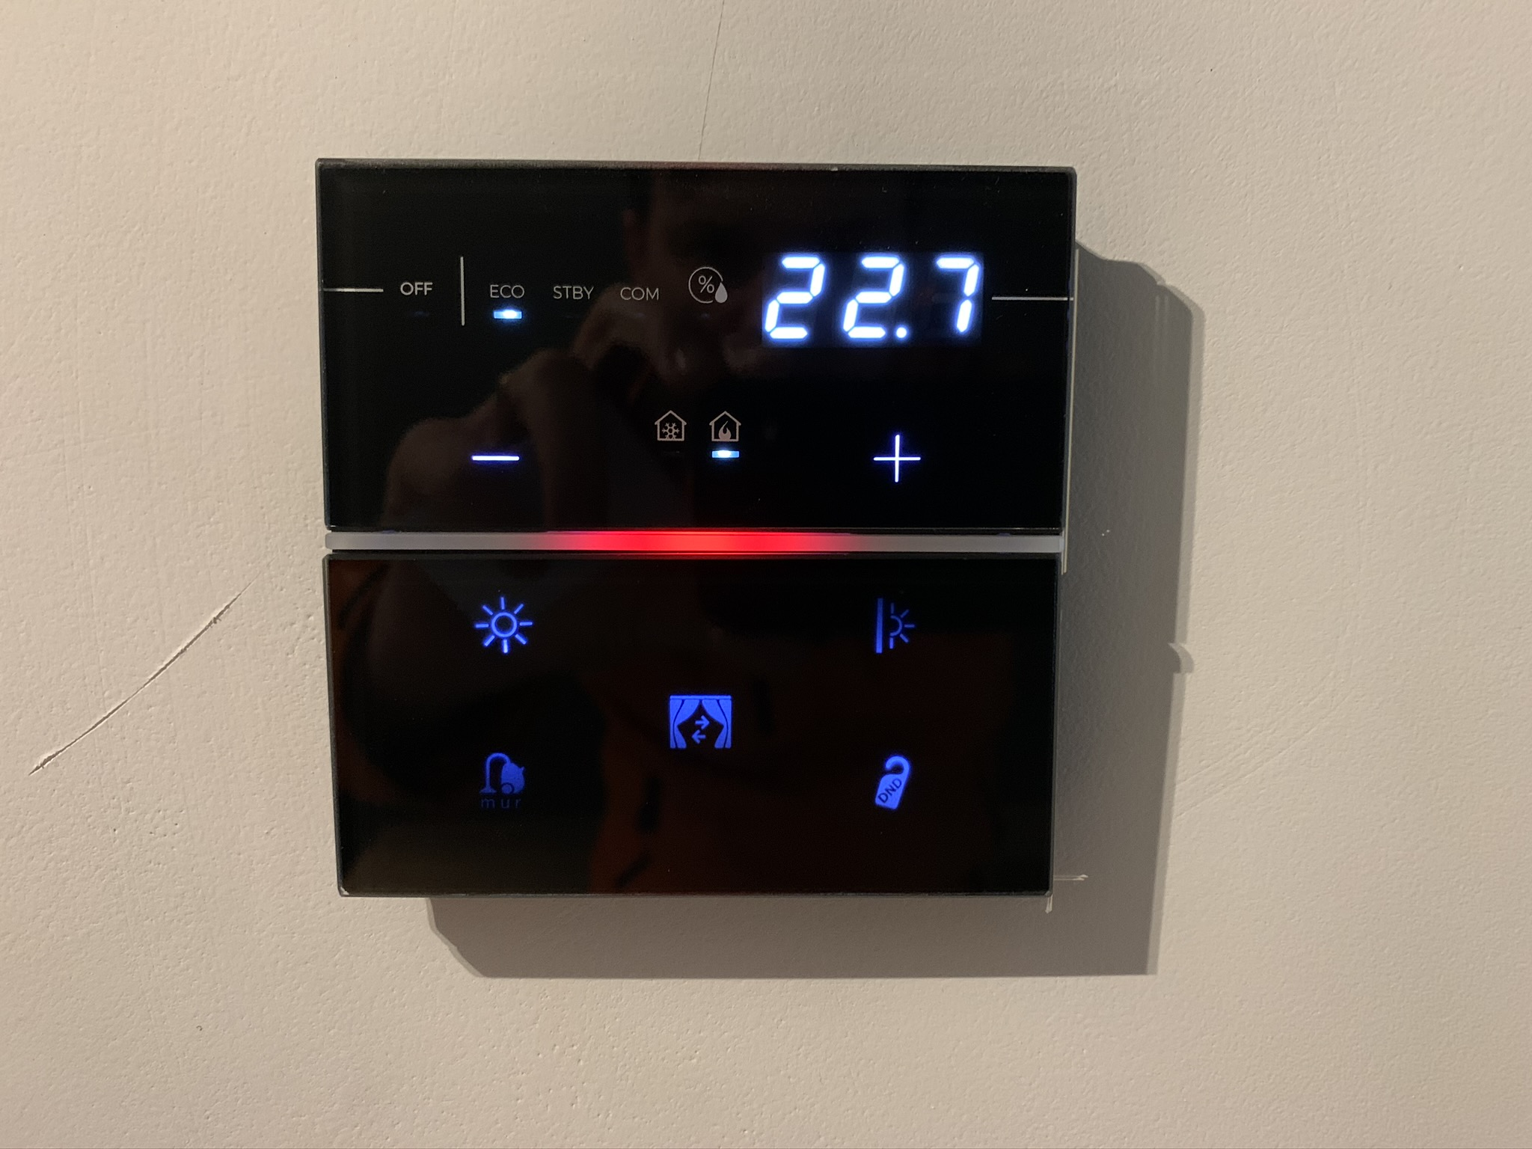
Guest Rooms – Comfort+
Each guest room is equipped with KNX devices that allow customers easy control of the utilities in the rooms: lights, curtains, temperature and hotel signaling – DND/MUR.
For increased comfort every room is equipped with one Samsung tablet used for visualization/controlling all the functions of the room and present other possible information (attractions in town, taxi numbers, restaurant and bar menu …)
Virtual holder system; solution based on presence sensors which detect if the room is occupied or not
Air flow control performed by automation of the variable air volume units

Slide 4
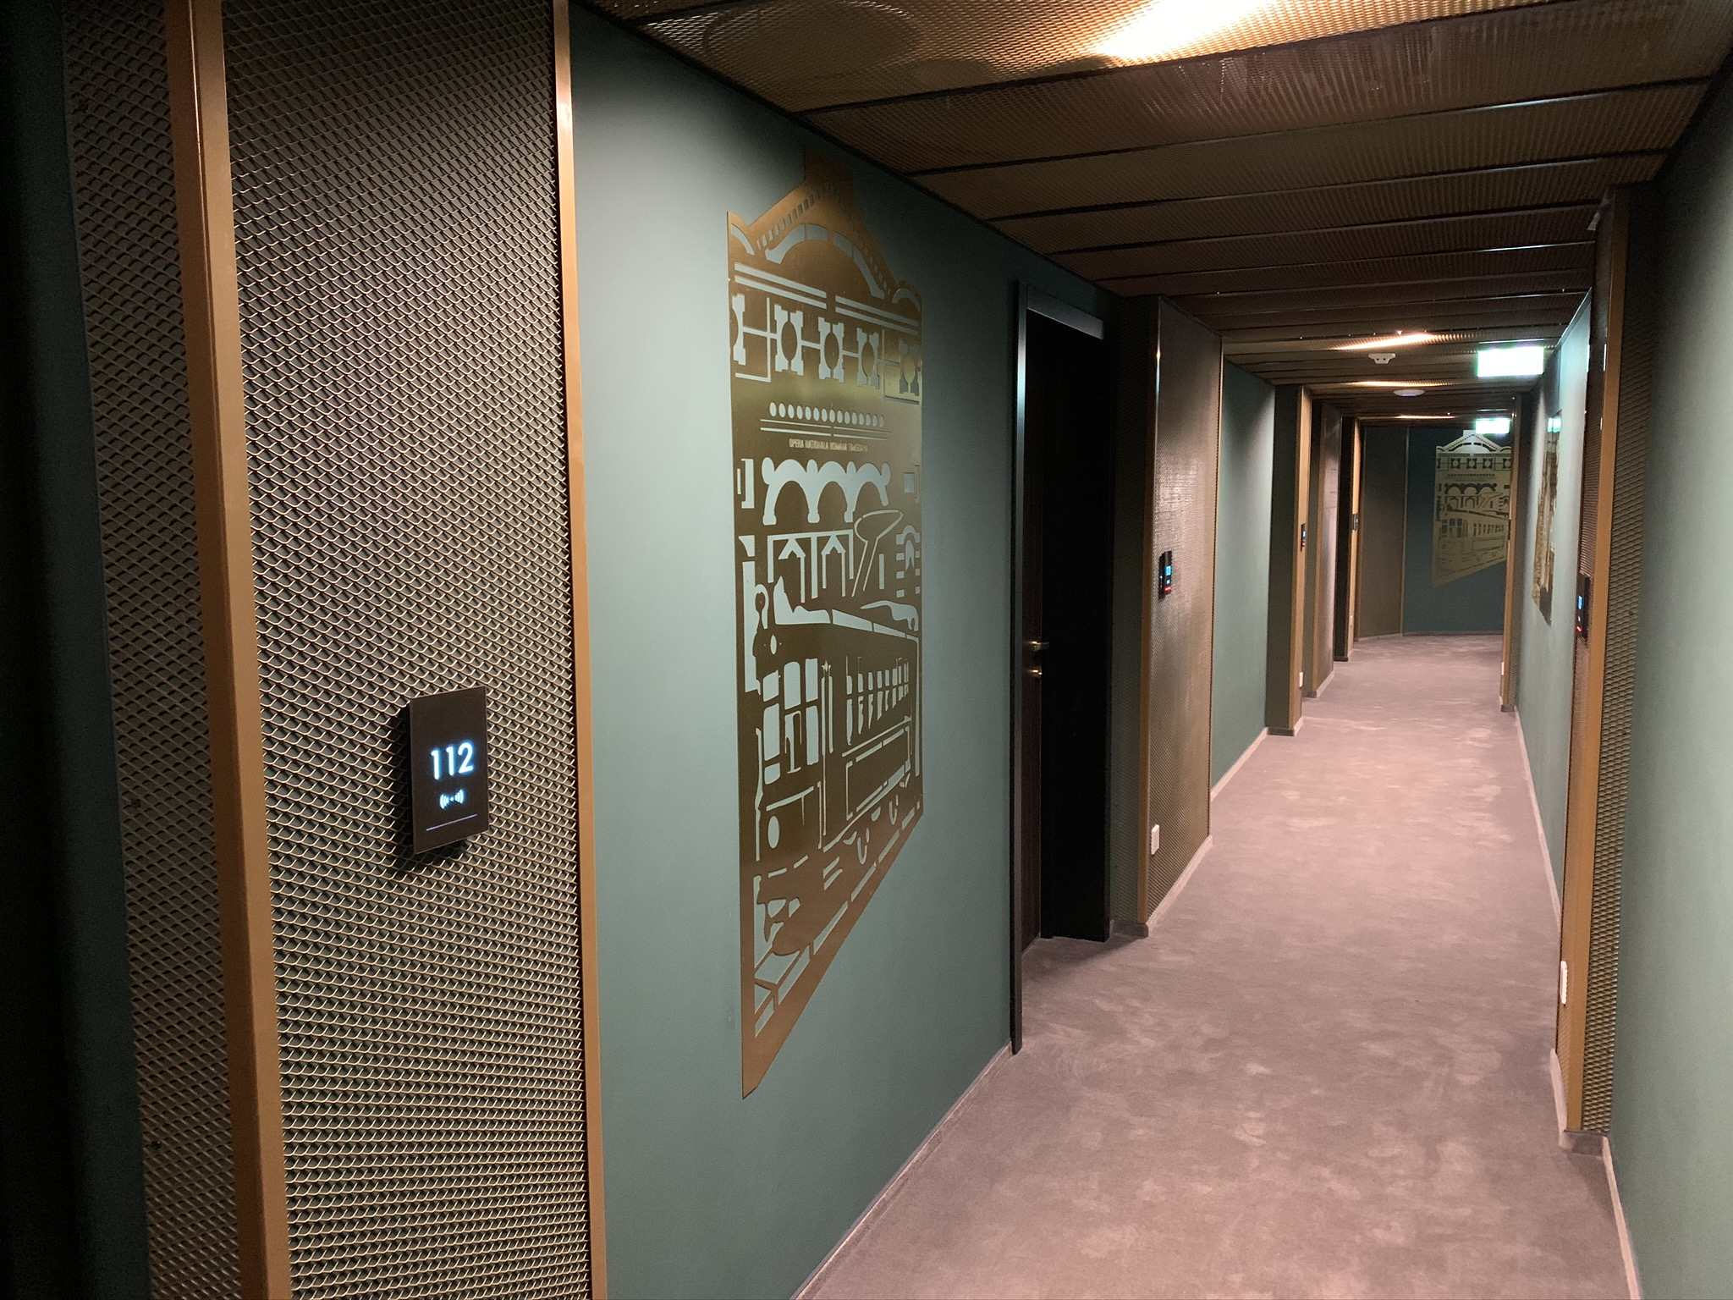
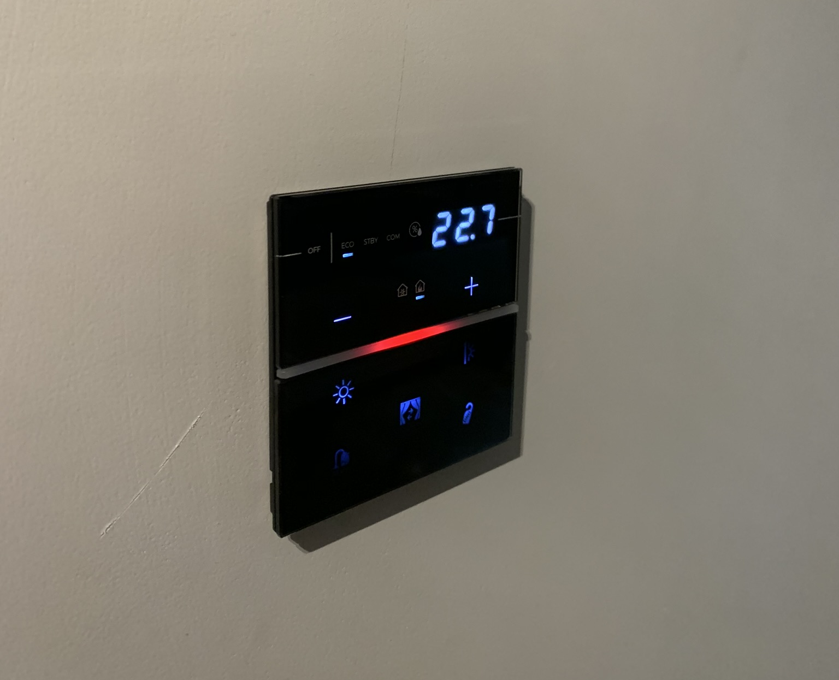
Guest Rooms – Energy-Saving
Temperature control is realized based on information provided from BMS system:
Status of room (booked/checked in/checked out)
Presence in room – information provided from virtual holder system; solution based on presence sensors which detect if the room is occupied or not
Window status (open/close)
Clean air provided from air handling units is controlled from KNX system and the level of ventilation is changed automatically based on information provided from virtual holder system (occupied/ not occupied).
Integration with Micros Fidelio, VingCard system complete the building management system and allow complex scenario: based on check-in signal from MICROS Fidelio hotel management system can be used to automatically start different actions like turning on the light or switch to comfort mode of the HVAC system without any actions taken from the hotel staff. The receptionists have the possibility to adjust the room setting to the customers’ needs e.g. lounge feeling, more lights, etc.

Slide 5
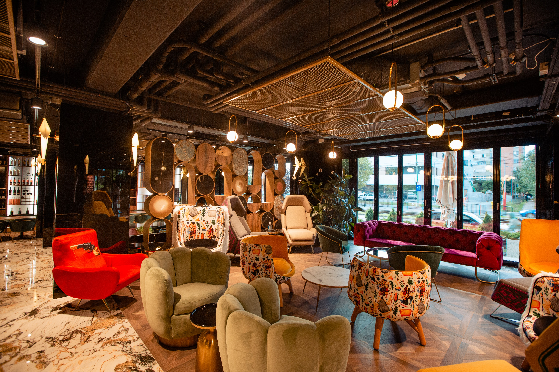
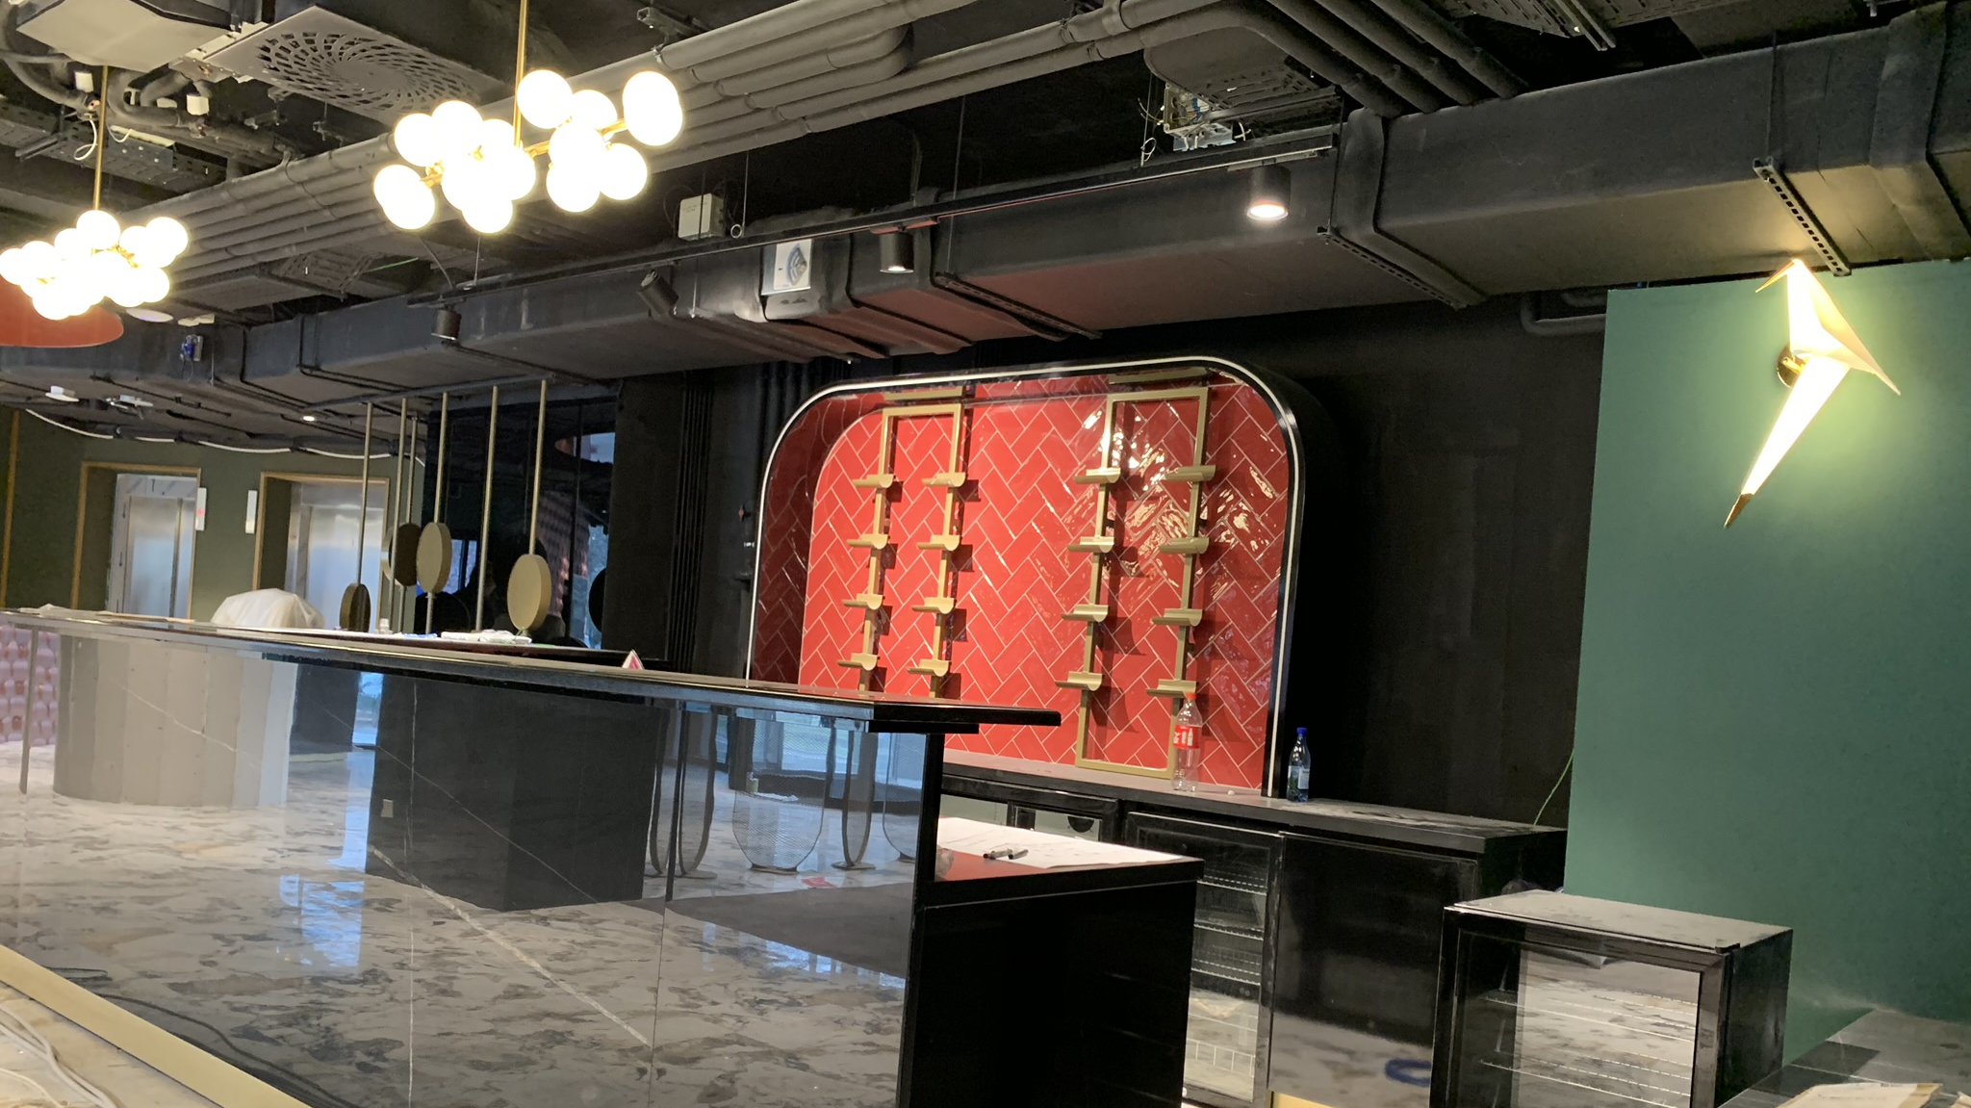
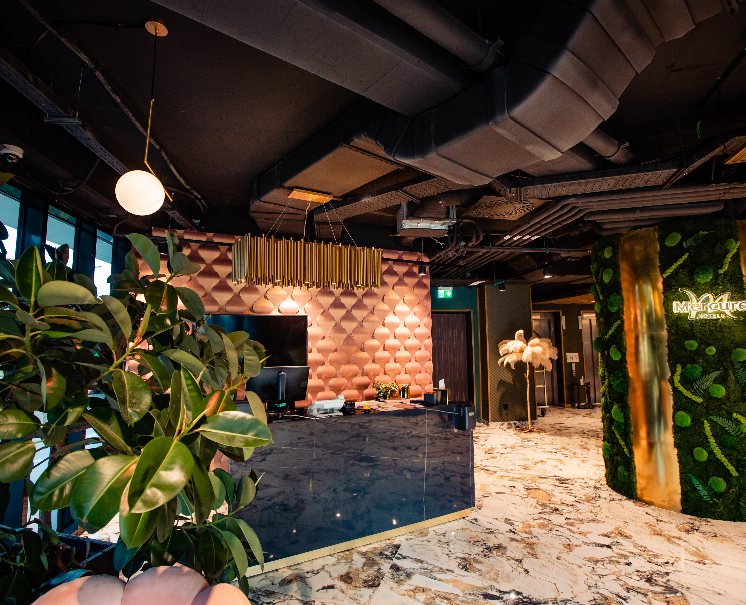
Common areas – Lobby, Meeting rooms, Restaurant and bar
True Presence Multisensor KNX equipped with 7 senses for intelligent buildings (true presence, brightness, room temperature, humidity, air quality, volatile organic compounds and CO₂) used to control KNX Light Dimming System based on DALI lights and provide information for temperature control. Air quality information is transmitted to the air handling unit based on integration in BMS to maintain the environment clean
Control of DMX RGB lights used for architectural lighting have also been achieved well through KNX.
Audio system based on multiroom solution is integrated in BMS software for an easy interaction and control
Visualization is widely implemented with powerful management tools and KNX devices scanning for faults.

Slide 6
Hotel Mercure
Devices: more then 400 device - KNX switches acutators, dimmers, FCU controllers, blind actuators, DALI gateways, DMX controllers, ModBus PLC and input/output modules, Glass KNX switches and thermostat devices, sensors
Technology: KNX, Modbus, DALI, DMX, Fidelio/Opera, VingCard, web services (http)
BMS Server: 5,000 data points / 15,000 group addresses
Visualization: 3 types of visualization – 5 clients with full system, 60 for guest rooms and 10 for staff with different rights

